Slide 1
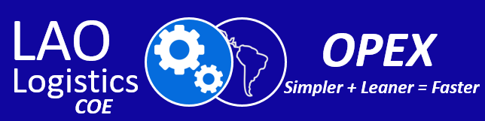
LAO LOGISTICS OPEX
Metrics - KPIs
7 de Abril 2020

Slide 2
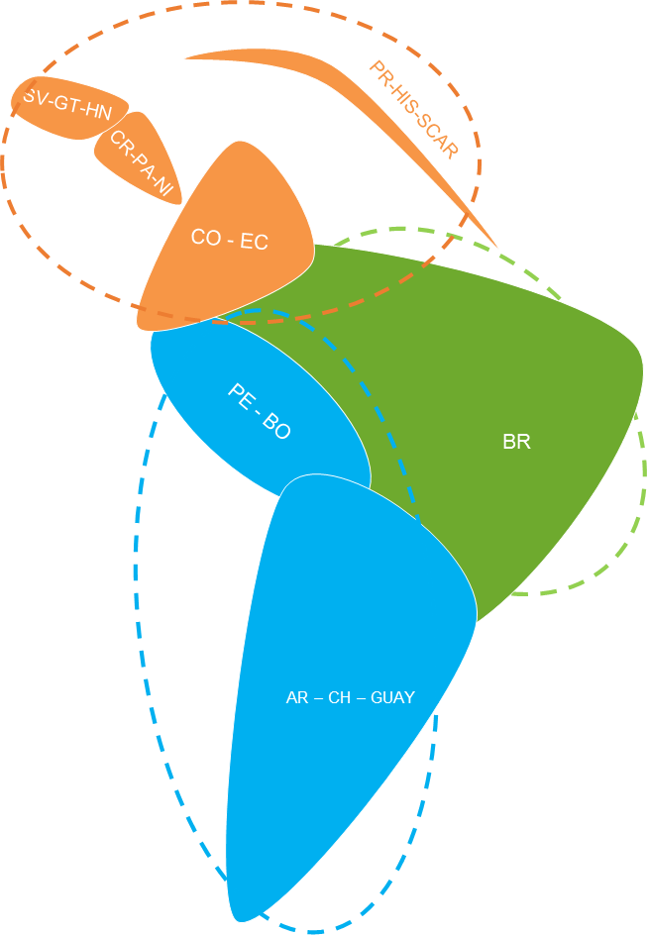
Generar Indicadores/Metricas Locales/Regionales que nos permitan tener una visión general de la Operación de nuestros CEDIs, pudiendo tomar deciciones en forma ágil y rápida
Proposito

Slide 3
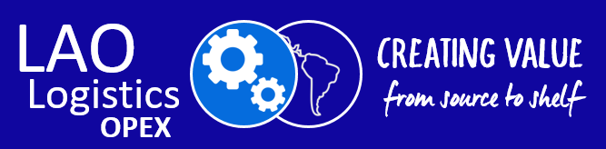
Proposito
Generar Indicadores/Metricas Locales/Regionales que nos permitan tener una visión general de la Operación de nuestros CEDIs, pudiendo monitorear todos loa procesos y tomar deciciones en forma ágil y rápida

Slide 4
Modelo OPEX Propuesto Macro-Procesos para CEDIs LAO
Management Processing
Inbound
Processing
Storage Processing & other states
Outbound
Processing
Internal movements and storage of materials
Storage/ Handling
Picking
Cross Docking
Co/Re-Packing
Quarantine & Blocked
Support all activities for planning and executing physical inventory in the corrects way and preservation & support all activities to manage a Warehouses
Inventory Management
Infrastructure Management
Safety
Quality MOVE
Resources & Capabilities
Traceability
Housekeeping
Customer Service Management
Transportation
Security
Procurement
Includes all the steps of an external process that occur when the products are received
Reception/ Receiving
Put-Away
Returns
All the processes to prepares and ship products to their destination
Load/Shipping
Packing/Staging
Standards
Metrics
Continues Improvement

Slide 5
Metricas Automaticas disponibles Actualmente
Dashboard Tableau Brasil
Implementadas | En Desarrollo
OEE – Montacargas RFT – Daño Movimentação (Cx) Controles Cross Tiempo de permanencia Carga & Descarga RFT - PPM | Costo Facturación Control de Palets

Slide 6
Indicadores Brasil
Dashboard Tableau
OEE – Montacargas
RFT – Daño
Movimentação (Cx)
Controles Cross
Tiempo de permanencia
Carga & Descarga
RFT - PPM
En desarrollo
Costo
Facturación
Control de Palets
Notes:
1 - Lo que tenemos listo
2 - En desarrollo

Slide 7
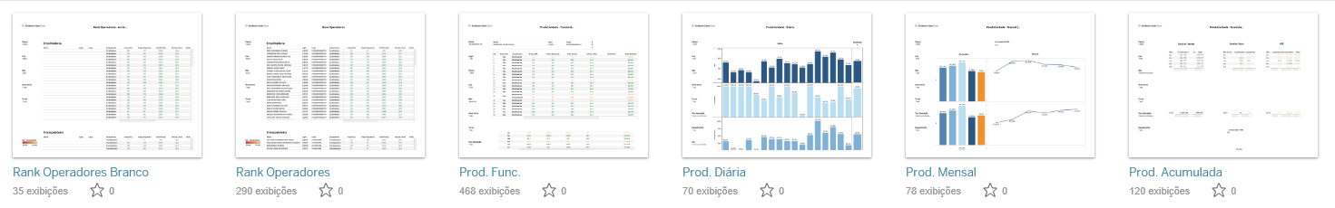
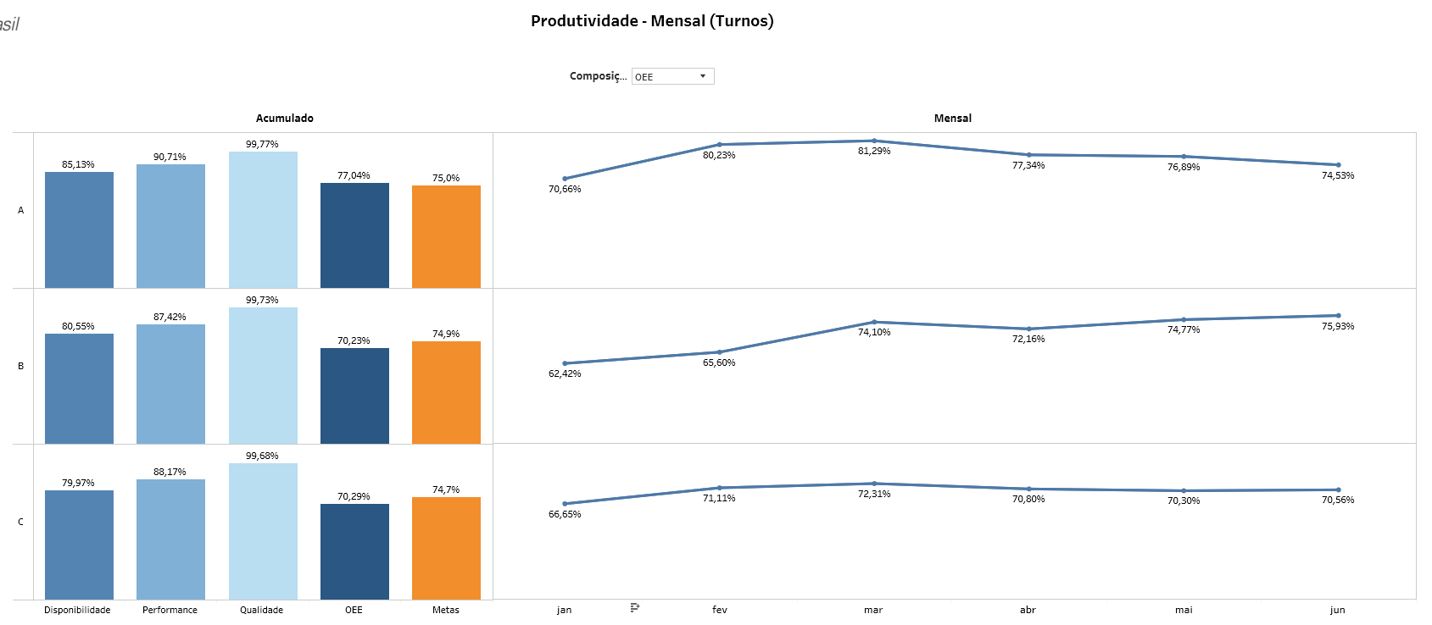
OEE – Monta Carga
SAP/WMS
LTRL
Memoria
de cálculo
% Disponibilidad
X
% Perfromance
X
Qualidad
=
OEE
Notes:
Overall Equipment Effectiveness – Eficácia geral do equipamento

Slide 8
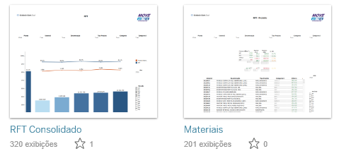
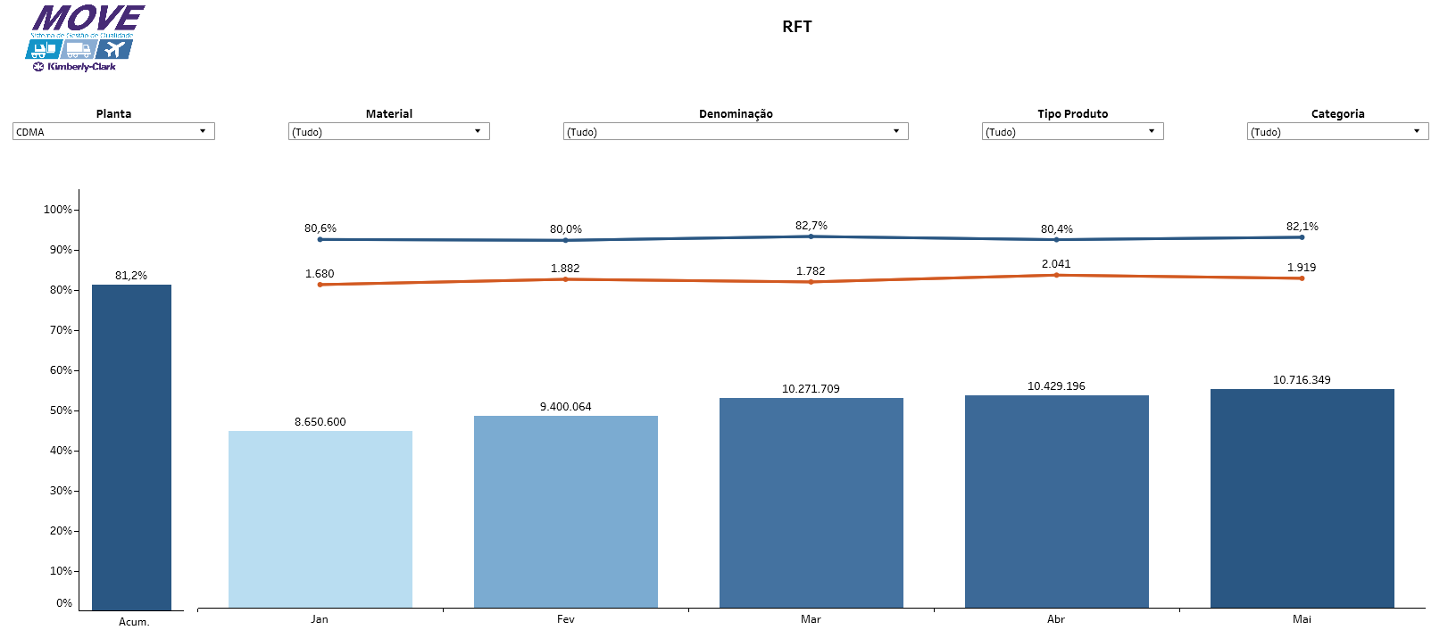
RFT - Avaria
SAP/WMS
MB51
Memoria de cálculo
1 - (Dano interno total/Movimiento totalx1000)
Notes:
1 - (Total Avarias Internas/Total Movimentaçãox1000)

Slide 9
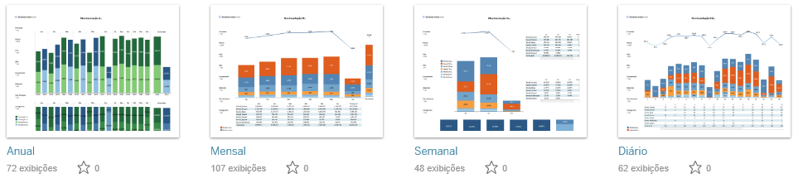
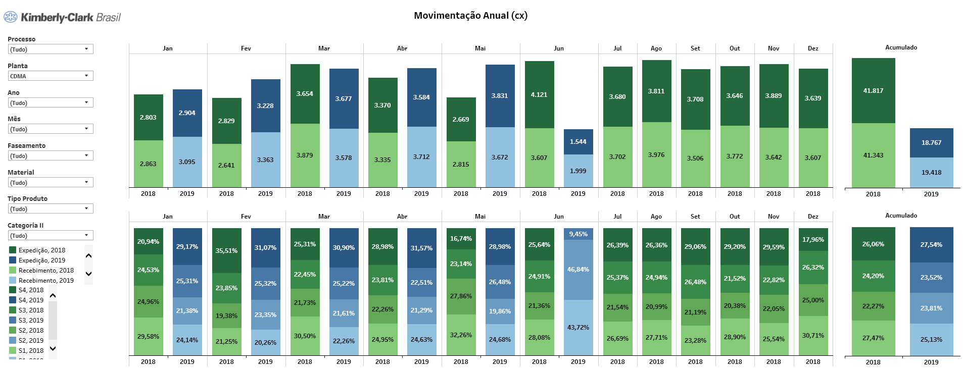
Movimiento Cajas
SAP/WMS
MB51
ZMB51

Slide 10
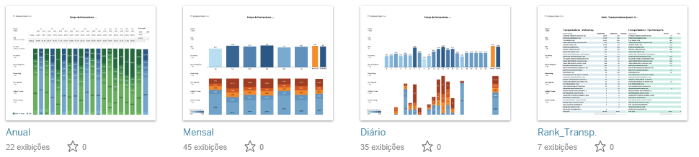
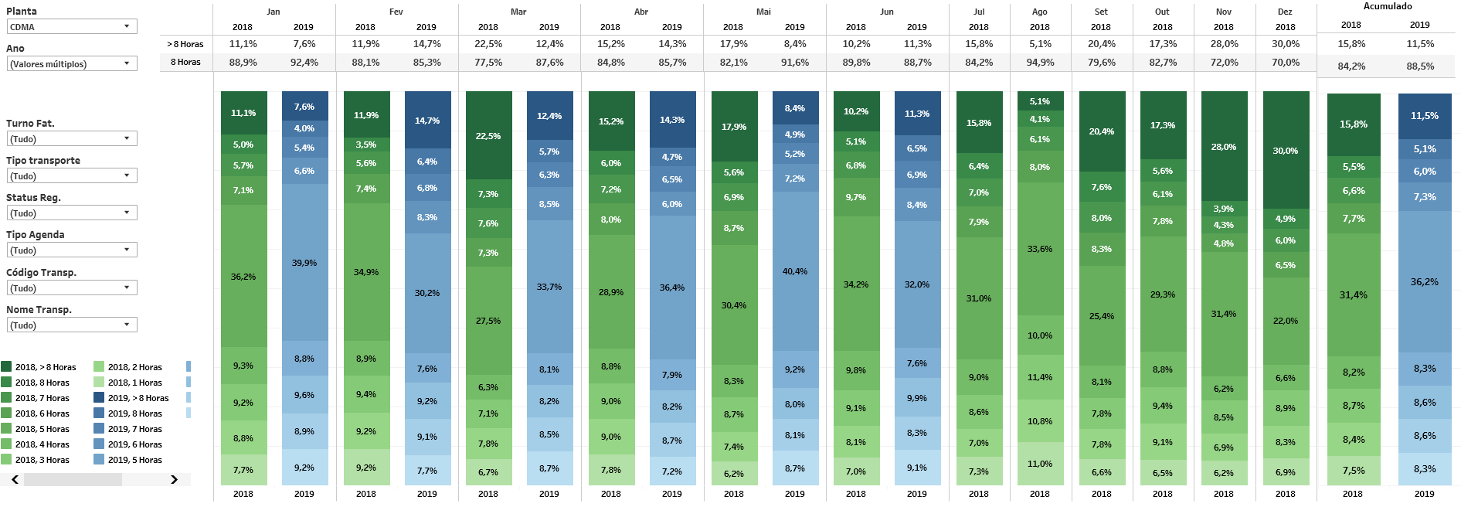
Duración de la estadia
SAP/WMS
ZMB51
MB51
Memoria
de cálculo
%Transporte por intervalo de tiempo

Slide 11
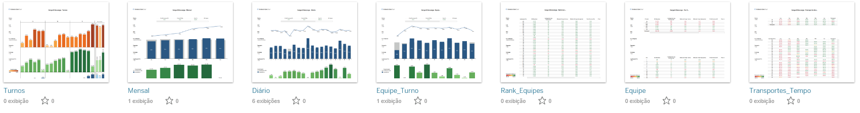
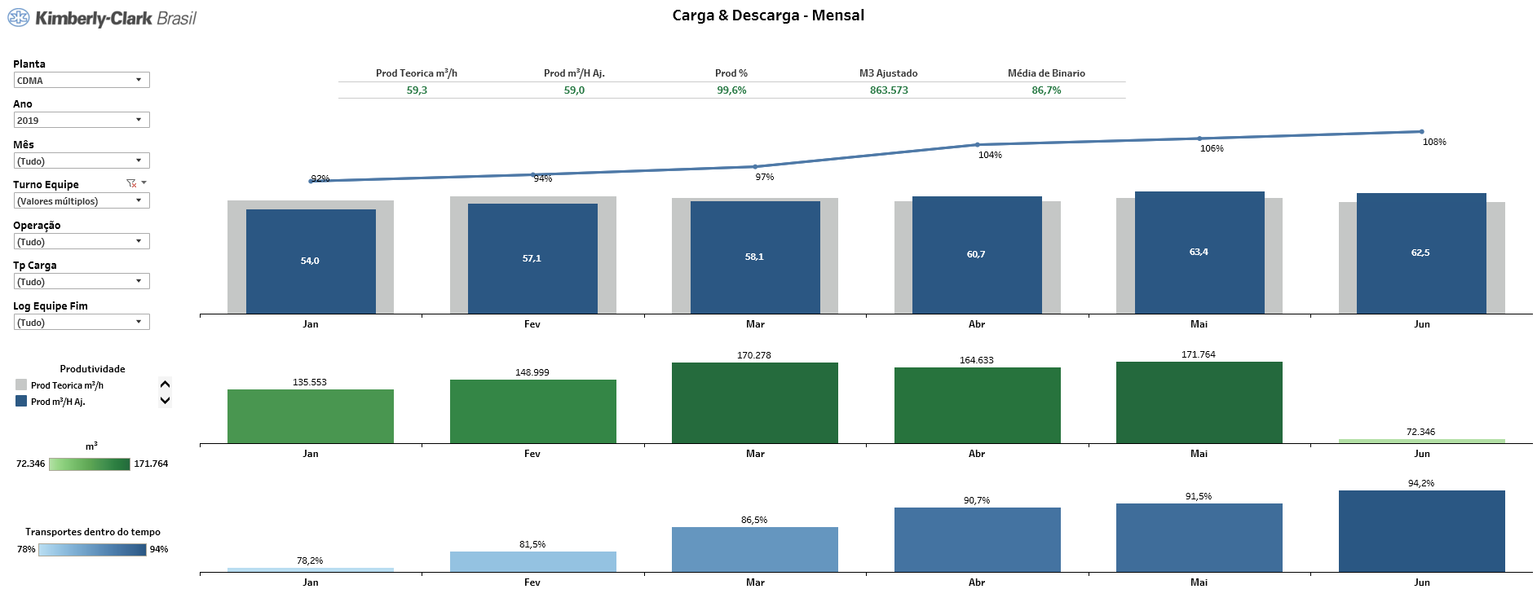
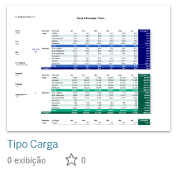
Carga & Descarga
SAP/WMS
Lamix
Memoria
de cálculo
Média M³/h
Total M³ cargado
% Transporte dentro do tiempo

Slide 12
Key Warehouse
Processes
The key to optimizing any warehouse process lies in the ability to collect and analyze data, review/improve existing processes, and introduce the right technology in the right places.

Slide 13
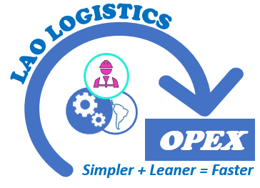
World Class Warehousing Macro-Process
Inbound
Processing
S
U
P
P
L
Y
E
R
S
C
U
S
T
O
M
E
S
Standards
Metrics
Continues Improvement
Warehousing Management Processing
Quality
MOVE
SAFETY
Resourses &
Capabilities
Maintenance Management
Inventory Management
Warehousing Storage Processing
Inbound
Processing
Storage & Handling
Outbound
Processing
Reception/ Receiving
Picking
Packing/Staging
Put-Away
Cross Dock
Load/Shipping
Returns
Co/Re-Packing
Quarantine & Blocked

Slide 14
LAO Warehouse Macro-Processes Proposal
Support all activities for planning and executing physical inventory in the corrects way and preservation
Inventory Management
Maintenance Management
Safety
Quality MOVE
Resourses & Capabilities
Management Processing
Inbound
Processing
Storage Processing & other states
Outbound
Processing
Internal movements and storage of materials
Storage/ Handling
Picking
Cross Docking
Co/Re-Packing
Quarantine & Blocked
All the processes to prepares and ship products to their destination
Load/Shipping
Packing/Staging
Includes all the steps of an external process that occur when the products are received
Reception/ Receiving
Put-Away
Returns
Standards
Metrics
Continues Improvement

Slide 15
Main activities and Key processes for the 3 Levers
Macro - Processes
Micro - Processes
Possible opportunities
Inbound Processing
Storage Processing &
other states
Outbound Processing
Management Processing
Management Processing
Reception/ Receiving
Put-Away
Returns
Storage/ Handling
Picking
Cross Docking
Co/Re-Packing
Quarantine & Blocked
Load/Shipping
Packing/Staging
Inventory Management
Maintenance Management
Safety
Quality MOVE
Resources & Capabilities
Operational Standards
Efficiency of times
Waste
Visual Management
Dialogues and performance boards Problem solving Leadership Agenda Continuous Improvement KPIs
Performance Culture
Cooperation
Communication and Information
Operating
Systems
Management
Infrastructure
Mindsets, Behaviors
& Capabilities

Slide 16
Key Warehouse Processes
Reception/ Receiving
To perform the process properly
Impacts of this process
How to Optimize:
Process:
The warehouse should be able to verify that it has received:
The right product
The right quantity
In the right condition
At the right time
Necessary Resources:
WMS system
Appropriate unload & stretch wrappers equipment
Trained staff
Stretch Wrapping standards
Product specs Palletized
Quality measuring instruments
Adequate Staging dimensions and/or available and safe place to product handling
Problems or No Problems on all subsequent operations
Transfer of responsibility for the goods to the warehouse.
Accountability on the warehouse for maintaining the condition of the goods
Responsibility to filter out damaged goods
Objective:
To receive cargo efficiently and correctly
To avoid accumulation at the receiving docks.
Solutions:
Power pallet trucks and conveyors to unload cargo and clear dock areas faster and more efficiently.
Right software to properly Put-Away goods & allocate the right amount of personnel to unload (WMS system, labor management systems and dock schedulers)
If it is necessary, dimensions automate the capture of weight and dimensions of pallets to accelerate your receiving processing

Slide 17
Key Warehouse Processes
Put-Away
OPEX
To perform the process properly
Impacts of this process
How to Optimize:
Process:
Put-away is the movement of products from the receiving dock to the most optimal warehouse storage location in a fast, efficient, and effective manner.
Necessary Resources:
WMS system
Appropriate unload equipment
Trained staff
Storage standards
Optimal Warehouses Lay-out design
Time study for travel time for individual tasks (staging to racks zone, to picking zone, to quarantine & locked zone)
Failing to place products in their most ideal location can impair the productivity of warehouse operation.
Benefits of put away properly:
Cargo is stored faster and more efficiently
Travel time is minimized
Safety of goods and employees is ensured
Warehouse space utilization is maximized
Cargo is easier and faster to find, track, and retrieve
Consequences of an incorrect process:
Possible customer loading error & more returns
Shipp locked product / non conform to customer
Inventory errors
Objective & Solution
Monitor Storage Capacity & Space Availability through WMS, using technology to track space utilization, or performing an ABC analysis to re-structure the warehouse layout
The warehouse must use barcode scanners (RFIDs) to automatically record tasks without any human intervention or use more advanced solutions, such as sensors to deliver real-time tracking of capacity and space
Reduce travel time of products from the receiving area to the storage location.
Use Fixed & Dynamic Locations that help increase the efficiency of the process . A fixed location can be associated with a specific product category (Wipes) or customer.
Keep the Warehouse Clean & Organized ( reduced risk, increase safety)

Slide 18
Key Warehouse Processes
Packing/ Staging
OPEX
To perform the process properly
Impacts of this process
How to Optimize:
Process:
Packing consolidates picked items in a sales order and prepares them for shipment to the customer . Is the operation’s ability to have products ready for departure, just in time for carriers to load their trucks.
For successful packing:
Use systems to release orders, for picking and packing in waves, aligned to specific delivery routes or carrier types(TMS/WMS).
Avoid late deliveries by scheduling picking waves to align with carrier picking up times.
A double check in the staging must be done by 2 different people. The first control is performed by the person who moves the product from the location to the dock, the second control must be performed by a "controller"
Packing is an extension of the picking process and must be system-managed and treated with care to ensure that orders are complete, and accurate
Potentially cause late deliveries: Products that are ready too early will clutter staging areas and dispatches that are late, will delay loading.
Possible increase in returns: If the packing is not properly prepared and loaded, customer return occurs.
Product damage: If weight, product fragility, etc. are not considered, as the products are in the staging, they can be damaged.
Inventory errors / Asset loss: if the load is not controlled, there may be missing or leftover products
Objective & Solutions
Have Product stored safely and efficiently on a pallet (Right Stretch wrapping) to be more easily to move
Appropriate equipment to move product from rack to staging
Trained staff
Have standards that allowed pepople to identify which products are more delicates

Slide 19
Key Warehouse Processes
Picking
OPEX
To perform the process properly
Impacts of this process
How to Optimize:
Process:
Picking is to collects products in a warehouse to fulfill customer orders.
It is the costliest process in the warehouse & the most important processes
Picking Strategy/ Methodology :
Single Order Picking: One employee is working on an entire order
Multi-Order Picking: One picker is working on different orders at the same time.
Forwarding System: An employees are picking one entire order, but sequential picking in work zones
Multi-Stage picking manual:The products are first picking in batch, and then classified for each order.
Multi-Stage Batch Picking with automated sortation:N employees are working on n orders parallel, the picking area is divided in zones.
Focusing on achieving higher accuracy, as errors can have a direct impact on your customer satisfaction.
Having an incorrect warehouse layout will require more walking time and most man-hours to complete picking operations.
Having the incorrect strategy could cause accidents and error in the customers orders
Objective:
Optimizing this process will allow you to reduce costs significantly and increase your warehouse efficiency.
Solutions:
Having the correct picking and automation strategy (single zone, multi zone)
Conducting an ABC analysis to improve the layout,
Selecting the Correct Picking Methodology
Having the right technologies.
Technologies such as mobile and wearables can streamline the picking process having access systems in real time and scan
Utilizing software to guide clerks in properly execution

Slide 20
Key Warehouse Processes
Storage/ Handling
OPEX
To perform the process properly
Impacts of this process
How to Optimize:
Process:
Products are placed into their most appropriate storage space.
For successful storage:
An efficient storage process in warehouses is critical because it ensures to make full use of all the available space in the warehouse.
Efficiency in warehouse storage also keeps the stocks organized without compromising productivity.
Calculate the Warehouse Storage Utilization using WMS System
Setting KPIs: Carrying Cost of Inventory, Storage Productivity, Space Utilization, Inventory Turnover, Inventory-to-Sales Ratio
Having an incorrect ABC Analysis will require more time to complete operations.
Having the incorrect calculate the Warehouse Storage Utilization will cause big operating problems
Having the correct Aisle widths & racks are crucial to maximaize the space utilization
Categories of Storage Technologies: Manual Alternatives:
Block Storage/ Floor storage
Selective Racking
Drive-in racks
Automatic Alternatives
Shuttle Systems
AS/RS or HBW
Objective & Solutions
When is done properly, the storage process fully maximizes the available space in the warehouse and increases labor efficiency.
Optimizing the storage process is only possible having right KPIs are properly tracked.
Having a software that automatically calculates the warehouse storage utilization and tracks the right storage KPIs (WMS)
Slotting optimization systems can help by assisting with the allocation of the best storage location for a given cargo.
Utilizing the right warehouse storage system according to the size of the facility and product mix allows to maximize spaces while improving warehouse efficiency.

Slide 21
Key Warehouse Processes
Load/Shipping
OPEX
To perform the process properly
Impacts of this process
How to Optimize:
Process:
Shipping is the final warehouse process and the start of the journey of products from the warehouse to the customer.
For successful shipping:
Only if the right order is sorted and loaded, is dispatched to the right customer, travels through the right transit mode, and is delivered safely and on time.
Previous processes are also vital to the success of shipping
The carrier must monitor the cargo and sign documentation to ensure that the product came out with the correct quantity and quality.
Necessary Resources:
Appropriate load equipment
Trained staff
Customer specs Palletized needs
Error in preload processes
Lack of resources to load the truck
Not having trucks with the proper specification to load
Have a truck delay
Not having the system or loads properly labeled for scanning and dispatching
Avoid late deliveries by scheduling picking waves to align with carrier picking up times.
Objective & Solution
Having right software systems to streamline many of the tasks is critical.
Allocate the right amount of resources to prevent over or under allocation.
Having a shipping mobile application and device lets you have the right information on hand and in real time
Having standards that clearly instruct how to load cargo safely and efficiently.
Have equipment and conveyors to load cargo and clear dock areas faster and more efficiently.

Slide 22
Key Warehouse Processes
Completar
Returns
OPEX
To perform the process properly
Impacts of this process
How to Optimize:
Process:
Returns is a complex part of the business:
When customers return products, they should seek, and be given Return Management Authorisation, which outlines what is being returned and why.
All returns must be traceable, to their order, document and invoice.
Having a clear returns process that delineates what is to be done with the products once received back into the warehouse (return to stock, re-pack, destroy, return to manufacturer)
Inventory must be updated where products are returned to stock.
Once the return is treated, you must return to the free-use stock for sale, with all labels that allow traceability
Problems or No Problems on all subsequent operations
Transfer of responsibility for the goods to the warehouse.
Accountability on the warehouse for maintaining the condition of the goods
Responsibility to filter out damaged goods
Objective:
To receive cargo efficiently and correctly
To avoid accumulation at the receiving docks.
Solutions:
Power pallet trucks and conveyors to unload cargo and clear dock areas faster and more efficiently.
Right software to properly Put-Away goods & allocate the right amount of personnel to unload (WMS system, labor management systems and dock schedulers)
If it is necessary, dimensioners automate the capture of weight and dimensions of pallets to accelerate your receiving processing

Slide 23

Key Warehouse
KPI Metrics

Slide 24
Key Warehouse KPIs metrics
Reception/ Receiving
OPEX
Cost of Receiving Per Receiving Line:
The expense that the warehouse incurs on the receiving process of each receiving line. This includes handling costs as well.
Receiving Productivity:
Determined in terms of labor by measuring the volume of products received per warehouse clerk per hour.
Receiving Accuracy:
Percentage of accurate trucks receipts, the proportion of received & unload trucks against trucks waiting outside the warehouse.
Dock Door Utilization:
Percentage of how many of the total dock doors were utilized.
Receiving Cycle Time:
The time taken to process each receipt.

Slide 25
Key Warehouse KPIs metrics
Put-Away
OPEX
Put-away Cost Per Line:
Expenses incurred for putting away stock per pallet, including labor, handling, Stretch Wrapping processe and equipment costs.
Put-away Productivity:
Volume of stock put away per warehouse clerk per hour.
Put-away Accuracy:
Percentage of number of items put away accurately at the designated location.
Labor and Equipment Utilization (OEE):
Percentage of the labor and material handling equipment utilized during the put-away process.
Put-away Cycle Time:
Total time taken during the entire process of each put-away task.

Slide 26
Key Warehouse KPIs metrics
Armar
Packing/ Staging
OPEX
Put-away Cost Per Line:
Expenses incurred for putting away stock per pallet, including labor, handling, Stretch Wrapping processe and equipment costs.
Put-away Productivity:
Volume of stock put away per warehouse clerk per hour.
Put-away Accuracy:
Percentage of number of items put away accurately at the designated location.
Labor and Equipment Utilization (OEE):
Percentage of the labor and material handling equipment utilized during the put-away process.
Put-away Cycle Time:
Total time taken during the entire process of each put-away task.

Slide 27
Key Warehouse KPIs metrics
Armar
Load/Shipping
OPEX
Put-away Cost Per Line:
Expenses incurred for putting away stock per pallet, including labor, handling, Stretch Wrapping processe and equipment costs.
Put-away Productivity:
Volume of stock put away per warehouse clerk per hour.
Put-away Accuracy:
Percentage of number of items put away accurately at the designated location.
Labor and Equipment Utilization (OEE):
Percentage of the labor and material handling equipment utilized during the put-away process.
Put-away Cycle Time:
Total time taken during the entire process of each put-away task.

Slide 28
Key Warehouse KPIs metrics
Armar
Picking
OPEX
Put-away Cost Per Line:
Expenses incurred for putting away stock per pallet, including labor, handling, Stretch Wrapping processe and equipment costs.
Put-away Productivity:
Volume of stock put away per warehouse clerk per hour.
Put-away Accuracy:
Percentage of number of items put away accurately at the designated location.
Labor and Equipment Utilization (OEE):
Percentage of the labor and material handling equipment utilized during the put-away process.
Put-away Cycle Time:
Total time taken during the entire process of each put-away task.

Slide 29
Key Warehouse KPIs metrics
Armar
Storage/ Handling
OPEX
Put-away Cost Per Line:
Expenses incurred for putting away stock per pallet, including labor, handling, Stretch Wrapping processe and equipment costs.
Put-away Productivity:
Volume of stock put away per warehouse clerk per hour.
Put-away Accuracy:
Percentage of number of items put away accurately at the designated location.
Labor and Equipment Utilization (OEE):
Percentage of the labor and material handling equipment utilized during the put-away process.
Put-away Cycle Time:
Total time taken during the entire process of each put-away task.

Slide 30
Key Warehouse KPIs metrics
Armar
Returns
OPEX
Put-away Cost Per Line:
Expenses incurred for putting away stock per pallet, including labor, handling, Stretch Wrapping processe and equipment costs.
Put-away Productivity:
Volume of stock put away per warehouse clerk per hour.
Put-away Accuracy:
Percentage of number of items put away accurately at the designated location.
Labor and Equipment Utilization (OEE):
Percentage of the labor and material handling equipment utilized during the put-away process.
Put-away Cycle Time:
Total time taken during the entire process of each put-away task.

Slide 31


¿Que hacer?
¿Qué inputs?
¿Cuáles indicadores?
¿Cómo se mide?
¿Cuál es el período de actualización?
Notes:
Para responder estas preguntas necesitamos la ayuda de todos

Slide 32
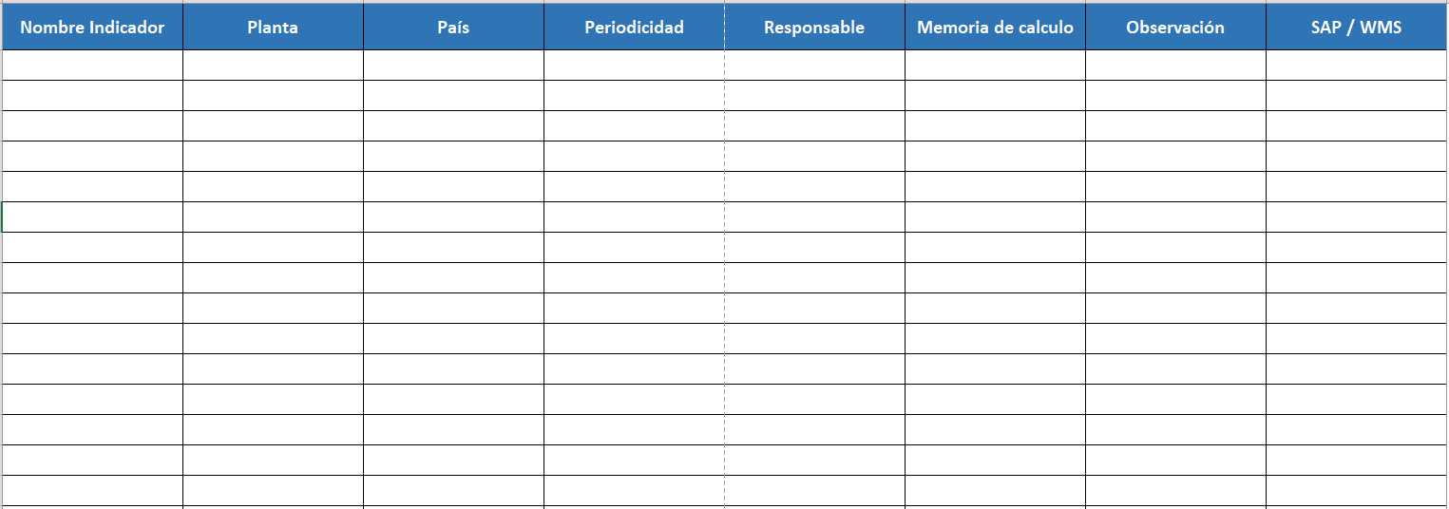
Mapeo de los principales indicadores

